Slide 1

Network Design and Management
Dr. Mahboob Qaosar
Associate Professor, CSE, RU
Week # 1

Slide 2
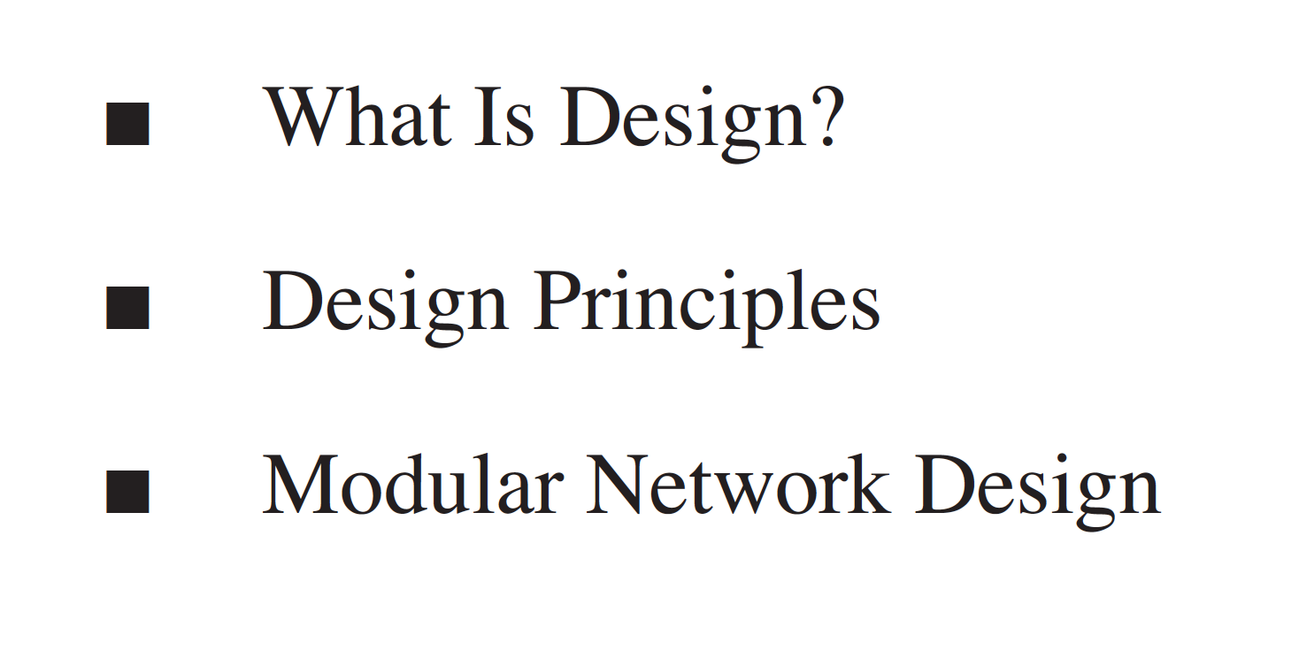
Chapter 1: Network Design

Slide 3
What is Design?
From dictionary:
Planning how to create something, or
The actual plans themselves
When Designing an Addition to a House, an Architect Needs to Have Knowledge of the Existing Structure and the Requirements for the Addition Along with Skills and Creativity.

Slide 4
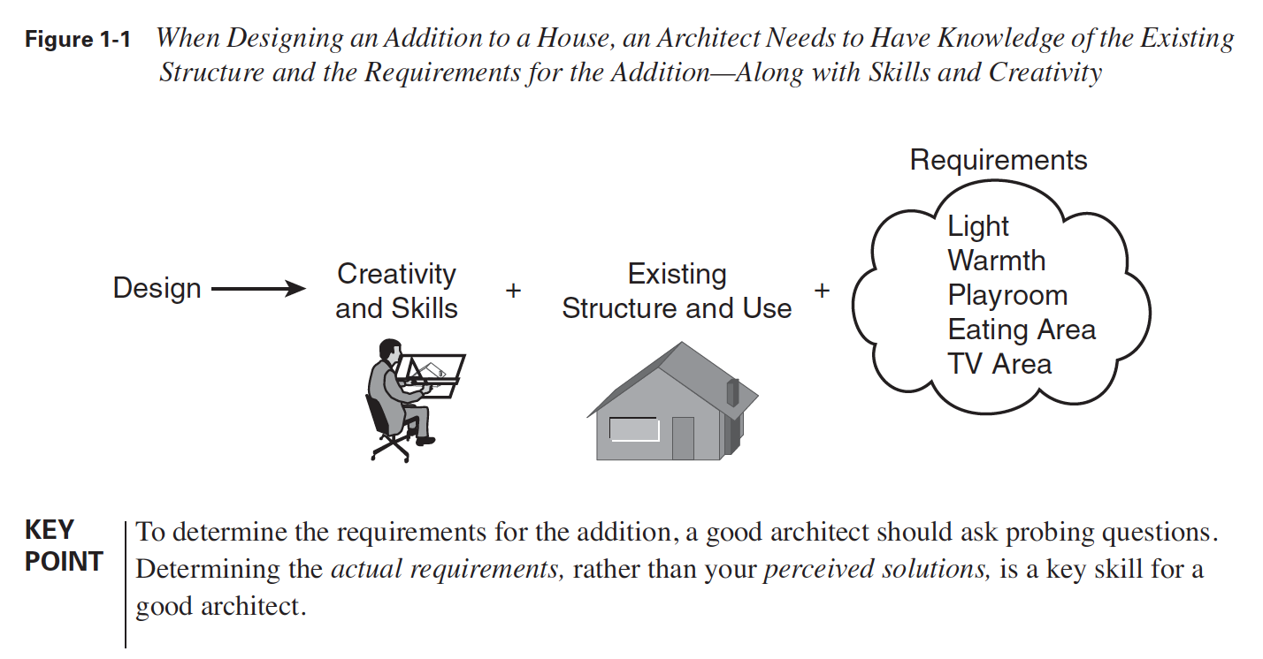

Slide 5
Network Design
A network design is no different- but how?
Understanding the requirements for the network, as well as knowing how the existing network is structured and used, is key to understanding how the new or updated network should function and which features should be included.
Understanding how the features operate,
what they do,
what their constraints are, and
what alternative approaches are available comes from both training and experience.

Slide 6

Design Principles
Cisco ?
Cisco has developed the:
PDIOO
Plan-Design-Implement-Operate-Optimize
network life cycle to describe the multiple phases through which a network passes.
This is the network design lifecycle – suggested by Cisco

Slide 7
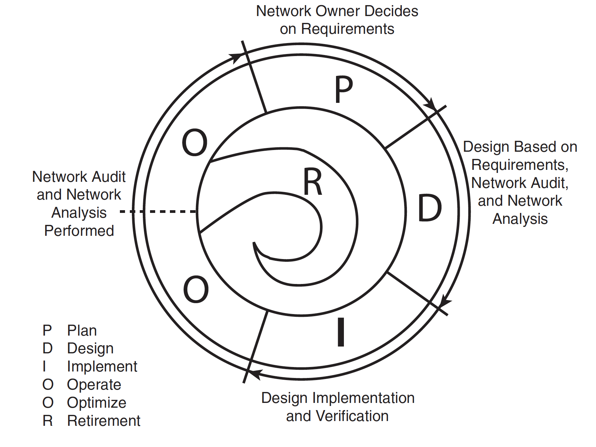
Plan-Design-Implement-Operate-Optimize (PDIOO)

Slide 8
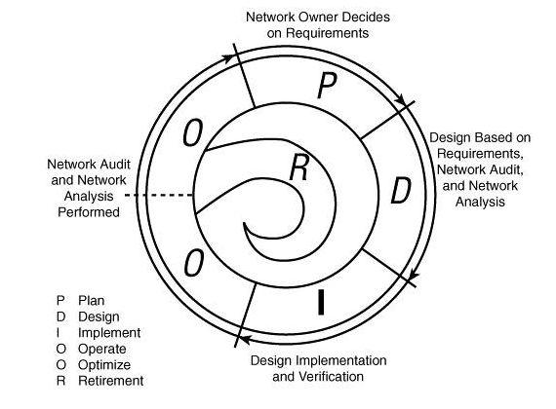
Plan-Design-Implement-Operate-Optimize (PDIOO)
Plan phase-
The detailed network requirements are identified, and
the existing network is reviewed.
Design phase
The network is designed according to the initial requirements and
additional data gathered during analysis of the existing network.
The design is refined with the client.
Implement phase
The network is built according to the approved design.

Slide 9
Plan-Design-Implement-Operate-Optimize (PDIOO)
Operate phase
The network is operational and is being monitored. This phase is the ultimate test of the design.
Optimize phase
During this phase, issues are detected and corrected, either before problems arise or, if no problems are found, after a failure has occurred. Redesign might be required if too many problems exist.
Retirement phase
Although not part of the PDIOO acronym, this phase is necessary when part of the network is outdated or is no longer required.

Slide 10
Network Designing Tasks
Network design should include the following tasks
Determine requirements
Analyze the existing network (if one exists)
Prepare the preliminary design
Complete the final design development
Deploy the network
Monitor, and redesign if necessary
Maintain documentation (as a part of all the other tasks)

Slide 11
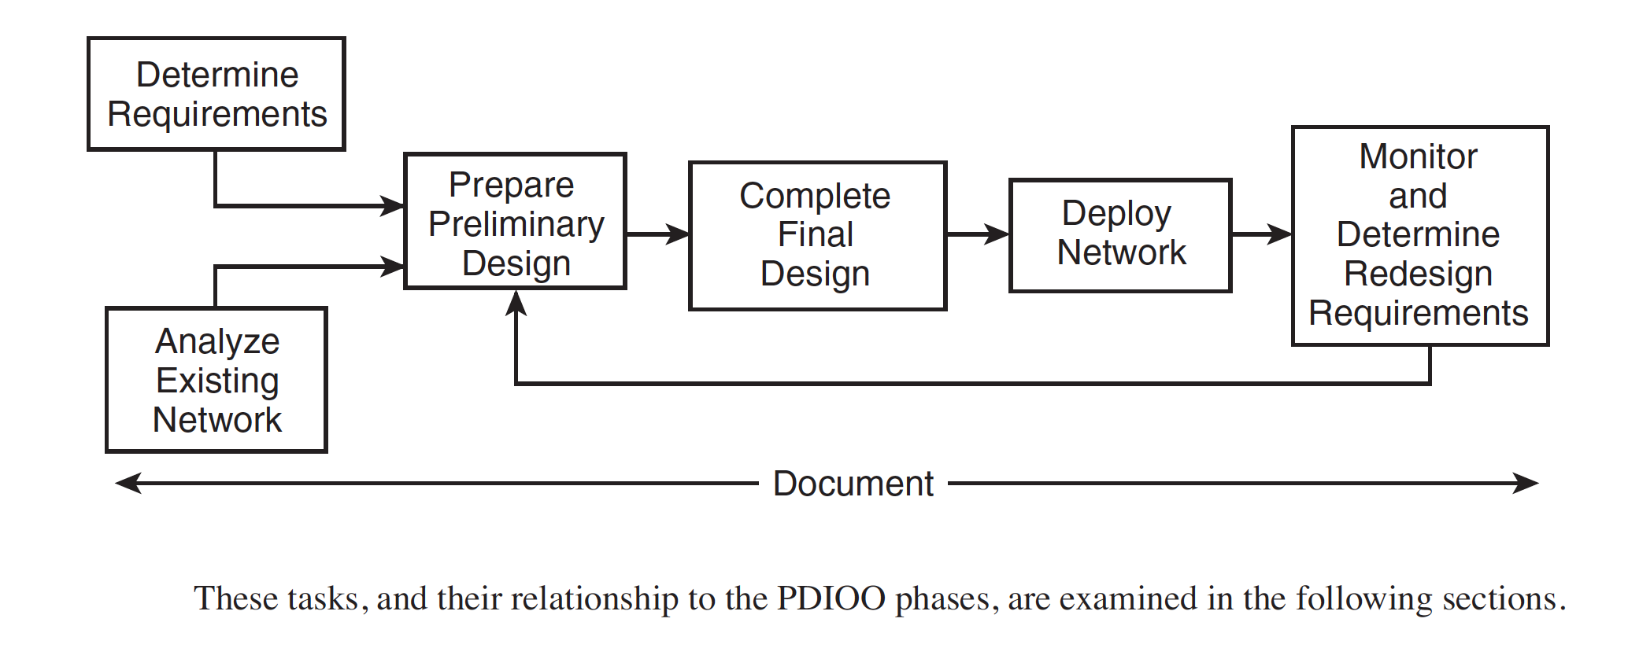
Network Designing Tasks
These tasks, and their relationship to the PDIOO phases, are examined in the following sections

Slide 12
Network Designing Tasks
Network design should include the following tasks
Determine requirements
Analyze the existing network (if one exists)
Prepare the preliminary design
Complete the final design development
Deploy the network
Monitor, and redesign if necessary
Maintain documentation (as a part of all the other tasks)

Slide 13
Determining Requirements
… is a part of the PDIOO Plan phase
… related to technical and business issues.
Technical issues :
Applications that are to run on the network?
Internet connections required?
Addressing restrictions ?
Support for IP version 6 (IPv6) addresses?
Other protocols that are to run on the network?
Cabling requirements?
Redundancy requirements?

Slide 14
Determining Requirements
Technical issues (cont):
Use of proprietary equipment and protocols?
Existing equipment that must be supported?
Network services required, including quality of service (QoS) and wireless?
How security is to be integrated into the network?
Network solutions required ? (for example, voice traffic, content networking, and storage networking)
Network management
Support for existing applications
Bandwidth availability

Slide 15
Determining Requirements
Business Issues:
Budget Capital (for new equipment) and operating (for ongoing expenses).
Schedule This could include the phasing out of older applications, hiring of new personnel, and so forth.
People Considerations include
who will install and operate the network,
what skills they have,
whether they require training,
whether any of these tasks will be outsourced, and so forth.

Slide 16
Determining Requirements
Legal Issues include any restrictions on the use and storage of data collected, whether the organization has contractual obligations or opportunities related to the network (for example, long-term maintenance or lease contracts), and so forth.
History Factors include examining the existing network's structure and determining whether any person or group will block changes or additions.
Policies Consider whether current organizational policies might restrict the network design.

Slide 17
Network Designing Tasks
Network design should include the following tasks
Determine requirements
Analyze the existing network (if one exists)
Prepare the preliminary design
Complete the final design development
Deploy the network
Monitor, and redesign if necessary
Maintain documentation (as a part of all the other tasks)

Slide 18
Analyzing the Existing Network
If this is a redesign of an existing network, the current network must be analyzed and understood.
Sometimes an existing network … restrict the network design …
for example, the existing cabling might not be optimal but might have to be kept for cost reasons.
Analyzing the existing network is typically done during the Optimize phase of the existing network; it could also be considered as part of the Plan phase for the new network.

Slide 19
Analyzing the Existing Network
We should analyze the network to determine both
what is good and
what should be changed
For example, the network might include virtual private network (VPN) connections so that employees can access corporate files through the Internet. If the organization is satisfied with this feature, this portion of the network might not have to be changed.

Slide 20
Network Designing Tasks
Network design should include the following tasks
Determine requirements
Analyze the existing network (if one exists)
Prepare the preliminary design
Complete the final design development
Deploy the network
Monitor, and redesign if necessary
Maintain documentation (as a part of all the other tasks)

Slide 21
Preparing the Preliminary Design
Preliminary design involves considering all the network requirements and constraints (including the budget), and determining viable alternative solutions.
The network owner is then consulted, and together an optimal solution is chosen; this solution is later developed into the final design.
Both the preliminary design and final design are done during the PDIOO Design phase.

Slide 22
Preparing the Preliminary Design
Two models that can be used for network design are examined
The hierarchical model and
The Cisco Enterprise Composite Network Model

Slide 23
Network Designing Tasks
Network design should include the following tasks
Determine requirements
Analyze the existing network (if one exists)
Prepare the preliminary design
Complete the final design development
Deploy the network
Monitor, and redesign if necessary
Maintain documentation (as a part of all the other tasks)

Slide 24
Completing the Final Design Development
Developing the final design involves:
producing detailed drawings,
configuration specifications,
costing, addressing plans,
and any other information required for implementation.
We can verify the design by implementing a prototype network, separate from the existing network.
Alternatively, a pilot network can be implemented within a portion of the existing network to verify that the design is feasible.

Slide 25
Network Designing Tasks
Network design should include the following tasks
Determine requirements
Analyze the existing network (if one exists)
Prepare the preliminary design
Complete the final design development
Deploy the network
Monitor, and redesign if necessary
Maintain documentation (as a part of all the other tasks)

Slide 26
Deploying the Network
Deployment of the network must start with a plan and a schedule.
Deployment planning starts in the PDIOO Design phase and continues into the Implement phase.
The deployment plan must include details of:
what is to be done and how it is to be done.
Scheduling … not only to identify when things will be done but also to determine who will do them, and what impact the deployment will have on the existing network.
Contingency plans – plans for what happens if a problem occurs during the implementation, should also be included.
how the network will be returned to a known working state

Slide 27
Deploying the Network
Any training required for personnel should be planned during this time.
Any contracts required should be negotiated during this time.
When the plans, schedules, contracts, and so on are in place, the network can be implemented.
Any problems found in the design during this phase must be corrected and documented.

Slide 28
Network Designing Tasks
Network design should include the following tasks
Determine requirements
Analyze the existing network (if one exists)
Prepare the preliminary design
Complete the final design development
Deploy the network
Monitor, and redesign if necessary
Maintain documentation (as a part of all the other tasks)

Slide 29
Monitoring and Redesigning
After the network is operating, baseline operational statistics should be gathered so that values for a working network are known.
The network should then be monitored for anomalies and problems.
If problems that require redesign occur, or if requirements change or are added, the appropriate design changes must be made and the entire design process should be repeated for that portion of the network.
Monitoring and redesign take place in the PDIOO Operate and Optimize phases, and can lead back into the Plan and Design phases.

Slide 30
Documentation
The design should be documented throughout the process.
Should Include
All the agreed-to requirements and constraints
The state of the existing network, if any
Preliminary design options and a brief review of why the final design was chosen
Final design details
Results of any pilot or prototype testing
Deployment plans, schedules, and other implementation details
Monitoring requirements
Any other pertinent information

Slide 31
Relationship in between
PDIOO and Network Design Tasks

